Slide 1
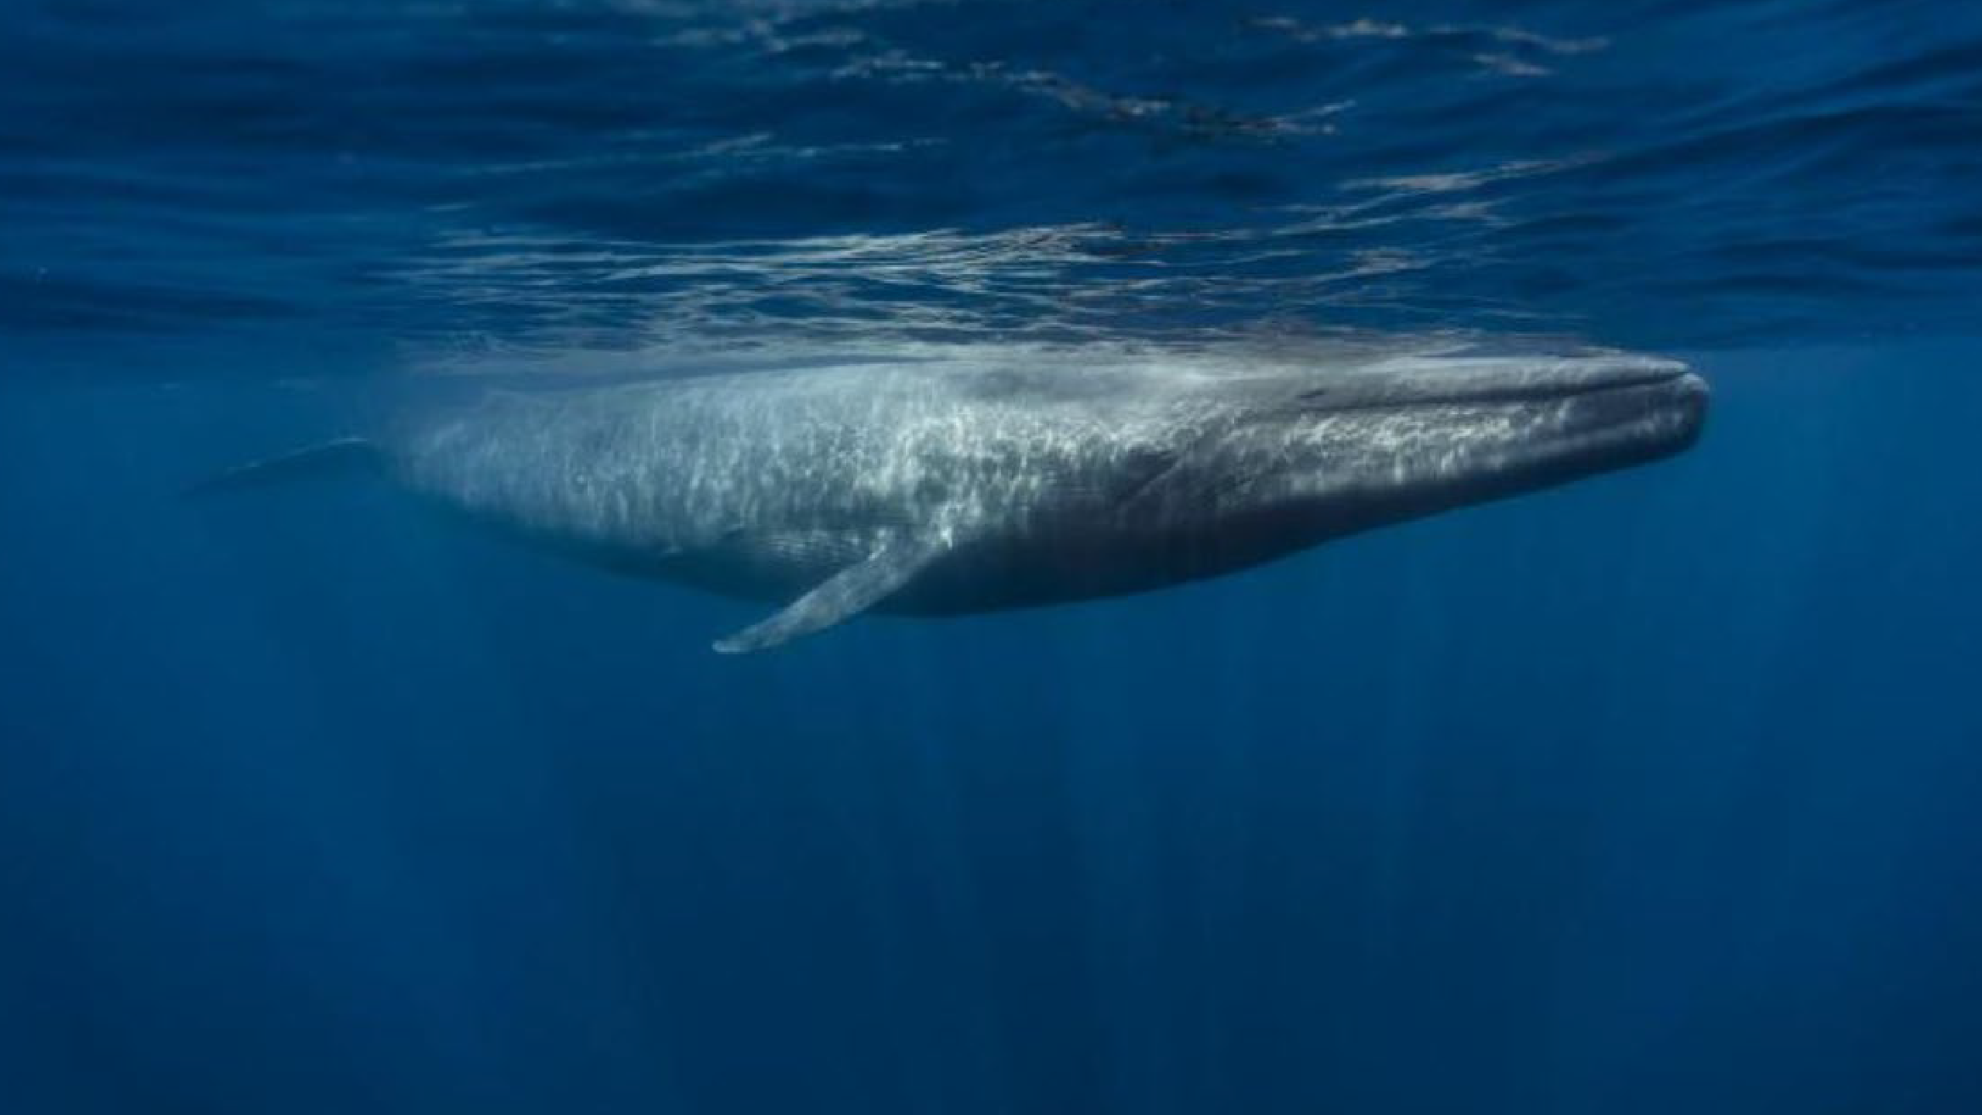


WORKPLAN AND BUDGET
FOR THE SPECIALLY PROTECTED AREAS AND WILDLIFE (SPAW) SUBPROGRAMME
FOR THE 2023 - 2024 BIENNIUM
UNEP(DEPI)/CAR WG.43/3
Tenth Meeting of the Scientific and Technical Advisory Committee (STAC) to the Protocol Concerning Specially Protected Areas and Wildlife (SPAW)
in the
Wider Caribbean Region
30 January – 1 February 2023
Ms. Sarah Wollring
Associate Programme Management Officer

Slide 2
Sub-programmes 2023-2024
2.1
2.2
2.3
2.4
2.5
Programme Coordination
Strengthening of Protected Areas in the Wider Caribbean Region Development of Guidelines for Protected Areas and Species Management
Conservation of Threatened and Endangered Species
Conservation and Sustainable Use of Coastal and Marine Ecosystems

Slide 3
Programme Coordination
2.1
Promote ratification of, accession to, and implementation of SPAW Protocol;
Ensure formulation and implementation of activities to satisfy requirements of the SPAW Protocol and its Contracting Parties;
Develop coordination, collaboration, and communication mechanisms with other agreements, organizations and programmes relevant to SPAW objectives;
Improve coordination of regional programming for protected areas and wildlife in the WC;
Oversee and coordinate SPAW Sub-Programme projects and activities.
Objectives

Slide 4
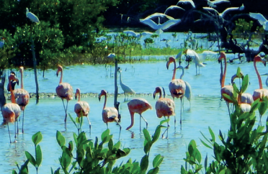
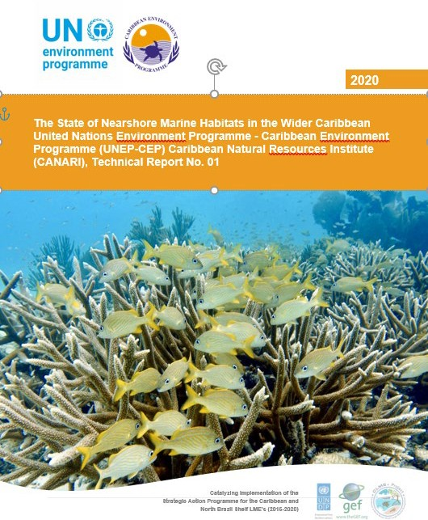
Programme Coordination
2.1
Implementation of SPAW STAC Recommendations and SPAW COP Decisions, and IGM/COP Decisions
Coordination with relevant programmes, donors and organizations to develop synergies and collaboration (CITES, IWC, CRFM, WECAFC, OSPESCA etc.)
Support to/Involvement in relevant global processes, initiatives and approaches (post-2020 GBF, Blue Economy, BBNJ, Blue Carbon, multifocal area projects)
Support implementation of existing Memoranda of Understandings (MoUs) and of collaborative arrangements with relevant MEAs and initiatives
Planned activities

Slide 5
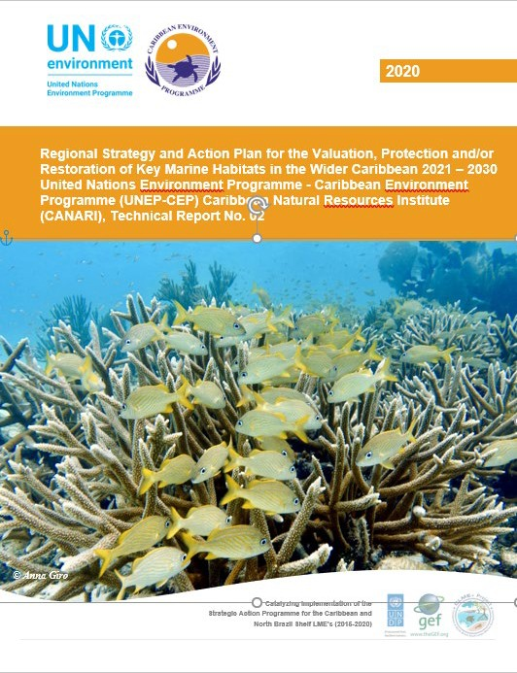
State of Nearshore Marine Habitats in the Wider
Caribbean Region

Slide 6











































Continued collaboration with relevant organizations and initiatives within and outside the region
Stakeholders & Civil Society Sargasso Sea Commission
Network of Experts
SPAW RAC Working Groups: Species (coral, mammals, invasive species, etc.)
Pas
Exemptions

Slide 7
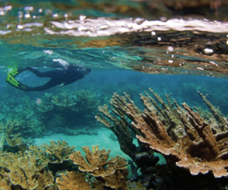
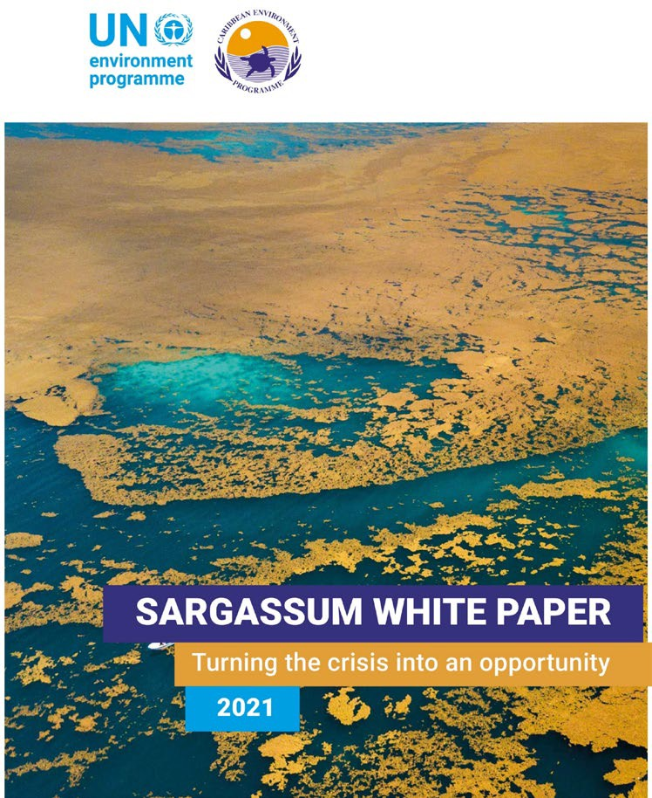
Programme Coordination
2.1
Develop new partnerships to strengthen the work of the SPAW objectives and address thematic /emerging issues (Ocean Acidification, Sargassum etc.)
Continue so support Contracting Parties in the implementation of the SPAW Protocol and development of its supporting regional sub-programme
Continue fundraising with relevant Governments, donors and organizations
Joint programming with SPAW-RAC
Planned Activities

Slide 8
Programme Coordination
2.1
STAC 11 and COP 13 successfully convened
2025-2026 SPAW Workplan developed
Funds raised
Enhanced participation of donors
Collaborations and synergies with relevant organizations
Greater involvement by Governments in SPAW
Additional Governments joining the SPAW Protocol
Expected Outputs

Slide 9
Strengthening of Protected Areas in the WCR
2.2
Strengthen management of parks and protected areas, including communication between parks and protected areas;
Assist Governments and NGOs with developing human capacity to increase the effectiveness of MPAs, both sites and national system;
Sensitize Governments of the need for and importance of financing protected areas, and promote the development of funding mechanisms and strategies;
Promote protected areas as important natural resources necessary for sustainable development.
Objectives

Slide 10
Strengthening of Protected Areas in the WCR
2.2
Strengthening of MPAs (prioritising MPAs listed under SPAW)
Enhance the network of MPA practitioners (*Subject to decision by SPAW COP12 and funding availability)
Continued development, maintenance and promotion of the Regional MPA Database
Synergies with national and international MPA initiatives and efforts
SPAW-RAC contribution
Planned Activities

Slide 11



ACP MEA Phase III
GEF IW Learn 5
● Component 3: Deliver Intra and Inter-Regional Coordination and Knowledge Management Across Focal Areas in Small Island Developing States to Improve Portfolio Performance
● Component 4: Deliver Support to Surface Freshwater, Groundwater and Large Marine Ecosystem Subsets in Support of Portfolio Strategic Priorities
Result 2.2 Functional Network(s) of SPAW-listed Protected Areas covering interconnected marine habitats and ecosystems for restoring and sustaining the health of the oceans.

Slide 12
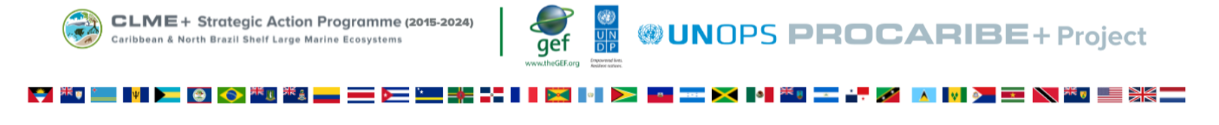
PROCARIBE+ Project
(activities and funds tbd)
Timeline
Objective
Implementation Countries
Implementing Agencies
Benefits to the Contracting Parties
4 years (2023-2027)
Protect, restore, and harness the natural coastal and marine capital of the Caribbean and North Brazil Shelf LME to catalyse investments in a climate-resilient, sustainable post-covid Blue Economy, through strengthened regional coordination and collaboration, and wide-ranging partnerships
Colombia, Costa Rica, Panama, The Bahamas, Belize, Cuba, Dominican Republic, Guatemala, Guyana, Honduras, Jamaica, St. Kitts and Nevis, Saint Lucia, Suriname, Trinidad and Tobago, Antigua and Barbuda
UNDP (GEF Agency), UNOPS, Others TBD (incl. UNEP CEP role yet TBD)
Training and capacity building opportunities: S2S/IRBM + ICZM/MSP + NDCs + Natural Capital Accounting + Remote Sensing; Enhanced protection of the region’s ocean/coasts; Advanced MSP in the region; Development of the CLME+ SAP: A 10-year SAP for the sustainable management of shared Living Marine Resources in the CLME+ region

Slide 13

GoM LME Project
Timeline
Scope
Implementation Countries
Implementing Agencies
Benefits to the Contracting Parties
4 years (2023-2027)
To facilitate the implementation of the Mexico/U.S. endorsed Transboundary Diagnostic Analysis (TDA – 2011) and Strategic Action Plan (SAP – 2013) for the integrated management of the GoM-LME. The SAP’s long-term Ecosystem Quality Objective (EcoQO) for the marine environment of the GoM is to improve water quality; enhance economic vitality by avoiding depletion and recover living marine resources; and conserve and restore coastal and marine ecosystems.
USA and Mexico
UNOPS, UNEP
The principal global benefit of the project is an enhanced understanding of LME functions, to serve as input into LME management strategies in support of the TDA and SAP processes, and to establish an enabling environment, and EBM practices that will contribute to the protection and maintenance of ecosystem functions and services.

Slide 14



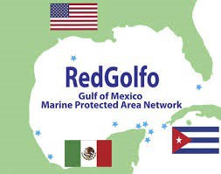


The networks
Consortium of networks of managers of MPAs
Network of networks
MPA networks
CaMPAM
NAMPAM
DCNA
MPA
connect
BIOPAMA
RedGolfo

Slide 15
Strengthening of Protected Areas in the WCR
2.2
Enhanced network of MPA practitioners
Improved dissemination of information on MPAs within the region
Stronger relationships and collaborations between MPA practitioners, scientists, fishers, other stakeholders, as well as with international/regional experts
Expected Outputs

Slide 16
Implementation of Guidelines for Protected Areas and Species Management
2.3
PROMOTE:
Implementation and Use of Guidelines on protected area establishment, management, and listing;
Implementation of National system planning for protected areas as a mechanism to develop relevant legislation and reporting mechanisms; and
Development and Implementation of Guidelines on species conservation and management
Objectives

Slide 17
Implementation of Guidelines for Protected Areas and Species Management
2.3
Listing of Protected Areas under the SPAW Protocol, Cooperation Programme and other Tasks of the PA Working Group
Criteria for the Assessment of Exemptions to Article 11(2) of the SPAW Protocol
Listing of Protected Species under the SPAW Protocol
Development of Conservation and Management Plans
Planned Activities

Slide 18
Implementation of Guidelines for Protected Areas and Species Management
2.3
An updated procedure for listing protected areas under the SPAW Protocol
An updated list of protected areas under the SPAW Protocol
Format for presenting exemptions under Article 11(2) is disseminated
Alignment with the procedure for the submission and approval of nominations of species for inclusion in, or deletion from Annexes I, II and III
Expected Outputs

Slide 19
Conservation of Threatened and Endangered Species
2.4
Promote awareness and action on priorities for management of endangered and migratory species;
Implement priority activities of existing species recovery and management plans;
Develop management plans and programmes for priority species of regional concern; and
Address the growing threat of invasive alien species that could negatively impact SPAW species and WCR habitats.
Objectives

Slide 20
Conservation of Threatened and Endangered Species
2.4
Conservation of:
              Marine Mammals
            Sea Turtles
            Fish Species
Support regional efforts to address invasive alien species in collaboration with relevant partners
Greater collaboration with CITES towards enforcement on illegal trade of species
Planned Activities

Slide 21
Conservation of Threatened and Endangered Species
2.4
Increased preparedness and response to anthropogenic impacts
Increased knowledge on megafauna critical habitat areas and increased support for transboundary protection
Support for regional repository on marine mammal stranding data
Strengthen relations with the IWC
Expected Outputs

Slide 22
Conservation of Threatened and Endangered Species
2.4
Existing Sea Turtle Recovery Action Plans (STRAPs) expanded, and new STRAPs developed
Standard guidelines and criteria for Index Site monitoring at sea turtle foraging grounds
Address the issue of regional invasive alien species
Increased work to conserve herbivorous fish species
Regional wildlife enforcement network supported
Expected Outputs

Slide 23
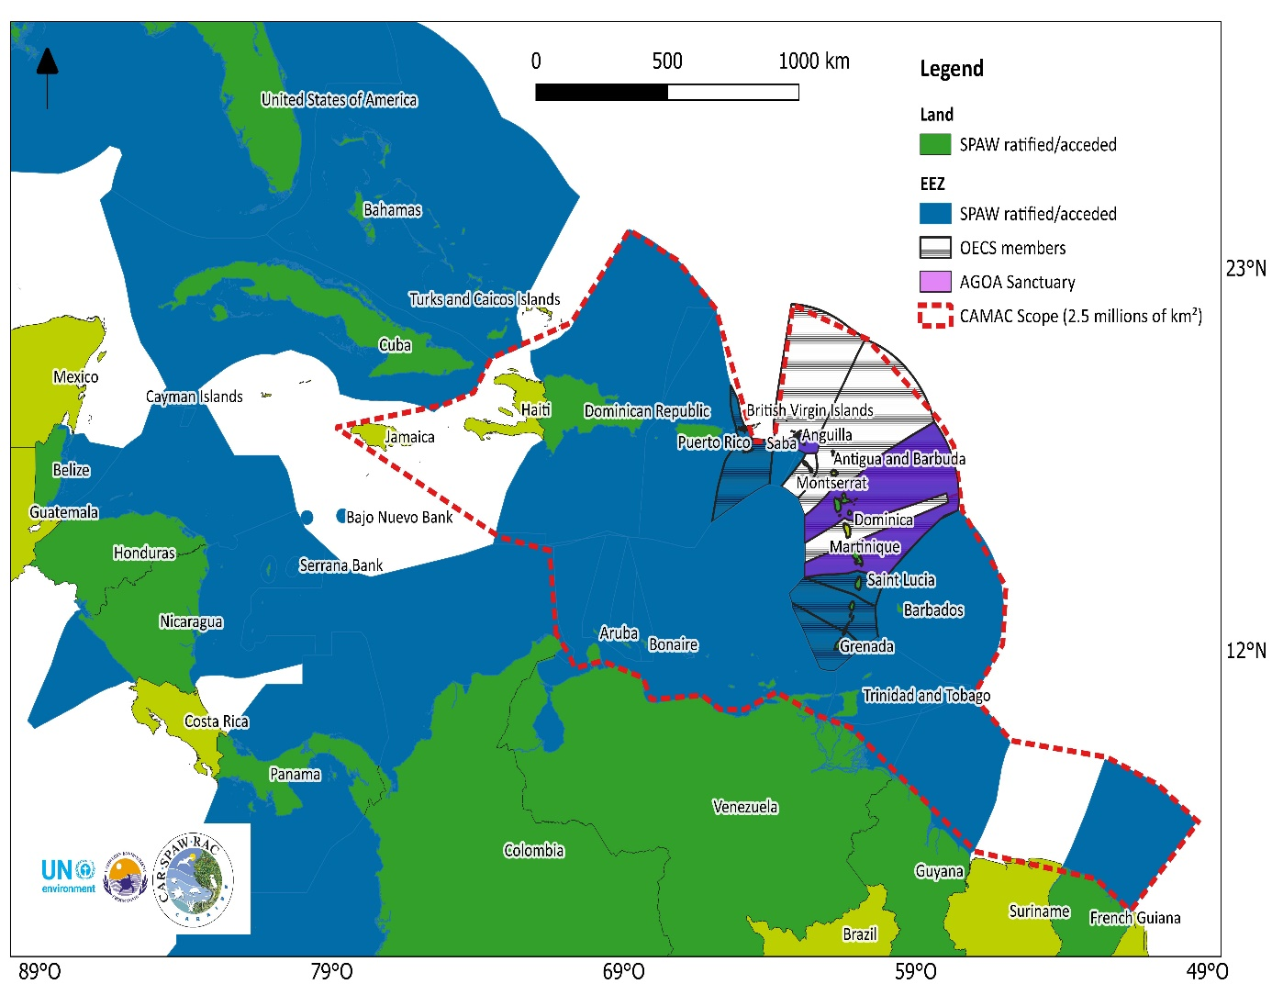



CAMAC PROJECT:
CARIBBEAN MARINE MEGAFAUNA AND ANTHROPOGENIC ACTIVITES
Objective: To provide the governing bodies of the Caribbean and environmental stakeholders with tools and recommendations aimed at reducing the impacts of human activities on large marine fauna in the region
©Paul Selvaggio

Slide 24
Conservation, Sustainable Use and Restoration of Coastal and Marine Ecosystems
2.5
Assist with sustainable management of coastal and marine ecosystems of the WCR;
Mobilise political will and actions of Governments and other partners for the conservation and sustainable use of coral reefs and associated ecosystems;
Effectively communicate the value and importance of coral reefs, mangroves and seagrass beds, including their ecosystem services, the threats to their sustainability, and the actions needed to protect them;
Promote the ecosystem based management (EBM) approach and the principles and values of good governance.
Objectives

Slide 25
Conservation, Sustainable Use and Restoration of Coastal and Marine Ecosystems
2.5
Conservation of:
Coral Reefs
Wetlands/Mangroves
Ecosystem Based Management Approaches
Sharing regional data and research on Sargassum
Planned Activities

Slide 26
Conservation, Sustainable Use and Restoration of Coastal and Marine Ecosystems
2.5
Reactivation of GCRMN-Caribbean
Harmonized data on biophysical and socio-economical coral reef monitoring
Development of a regional database to store and analyse data
Contribution to the GCRMN’s Status of Coral Reefs of the World Report
Harmonized mangrove and seagrass monitoring protocols in the WCR
Expected Outputs

Slide 27
Conservation, Sustainable Use and Restoration of Coastal and Marine Ecosystems
2.5
EBM management approaches promoted throughout the WCR
Resilience of coastal ecosystems against climate change pressures improved
Expected Outputs

Slide 28
***Subject to funding availability
2.1./2.4
2.2
2.3
2.4
Cooperate with relevant institutions on new or existing Invasive Alien Species (IAS) issue and contribute to reinvigorate IAS networks and initiatives
Reactivation of CaMPAM - estimated core operating budget ≈377 000$ (Martha Prada, 2022)
SPAW-RAC continue the database on SPAW-PAs, including web-based tool; continue efforts to simplify and update the procedure for listing of PAs; Update factsheets on the SPAW-listing process and listed sites previously prepared by Secretariat; Build dedicated spaces for each SPAW-listed PA using SPAW-RAC website (and CaMPAM database/sources); Activities related to protected areas and invasive species management while considering Sargassum
Support the implementation of the Marine Mammal Action Plan (MMAP), and subsequent actions
including, to enhance knowledge on marine mammal populations in the Caribbean, assess anthropogenic impacts, strengthen regional capacity to mitigate these threats and support the development of a marine mammal RAN;

Slide 29
***Subject to funding availability
2.5 (Coral Reefs)
2.5 (Sargassum)
Promotion and implementation of the Regional Guidelines for Coral Reef Biophysical Monitoring, Guidelines for Integrated Coral Reef Monitoring, and their promotion at relevant for a (GCRMN); Continue coral reef monitoring efforts; development of an action plan on coral reef conservation incl. capacity building and small grant funding; participation at global coral reef initiatives; continue work on Stony Coral Tissue Loss Disease (SCTLD); joint programming AMEP/SPAW on Sargassum; sharing of regional Sargassum data, including on impact on wetlands in collaboration with Ramsar CariWet Initiative; Collaboration with Sarg’Coop; development of information documents; coordination with other Regional Seas Programmes

Slide 30
Budget

Slide 31
Proposed Recommendations
Review of Operations, Functioning, and Financing of Regional Activity Centres and Regional Activity Networks of the Cartagena Convention: RAC/RAN Review Workplan 2022/2023 (UNEP(DEPI)/CARWG.43/INF.38)
→ The Secretariat proposes that SPAW STAC10 recommends to SPAW COP12 the endorsement for th eneed to update the broader RAC/RAN guidelines as presented in (UNEP(DEPI)/CARWG.43/INF.38).

Slide 32
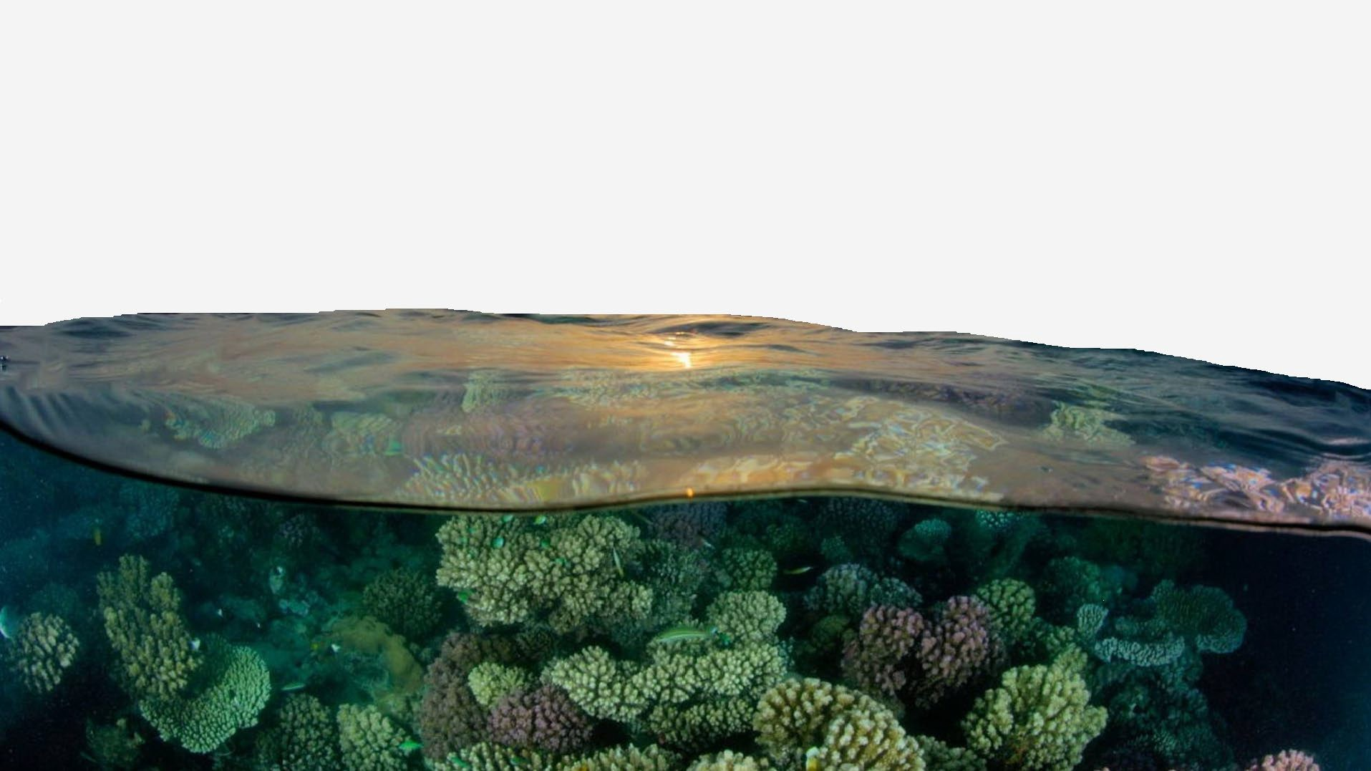

Thank you Merci Gracias

